Slide 1








IEEE
Appathon
By Siddhant Sunil Joshi

Slide 2
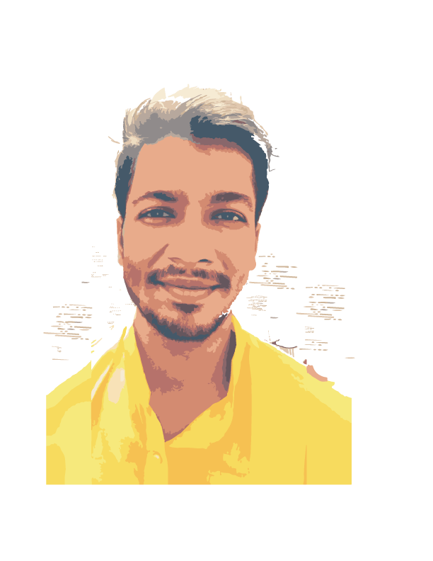
Siddhant Sunil Joshi
Student
Perusing Bachler’s degree in Electronics and Telecommunication Engineering at MVP’s KBTCOE,

Slide 3
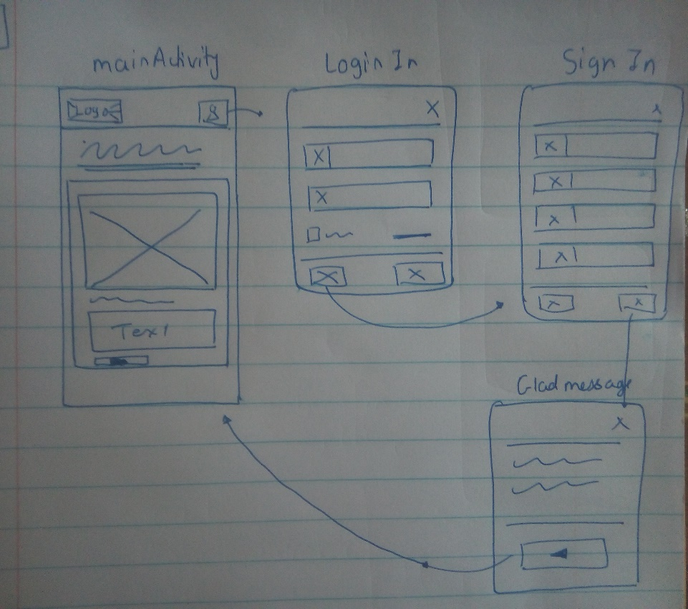
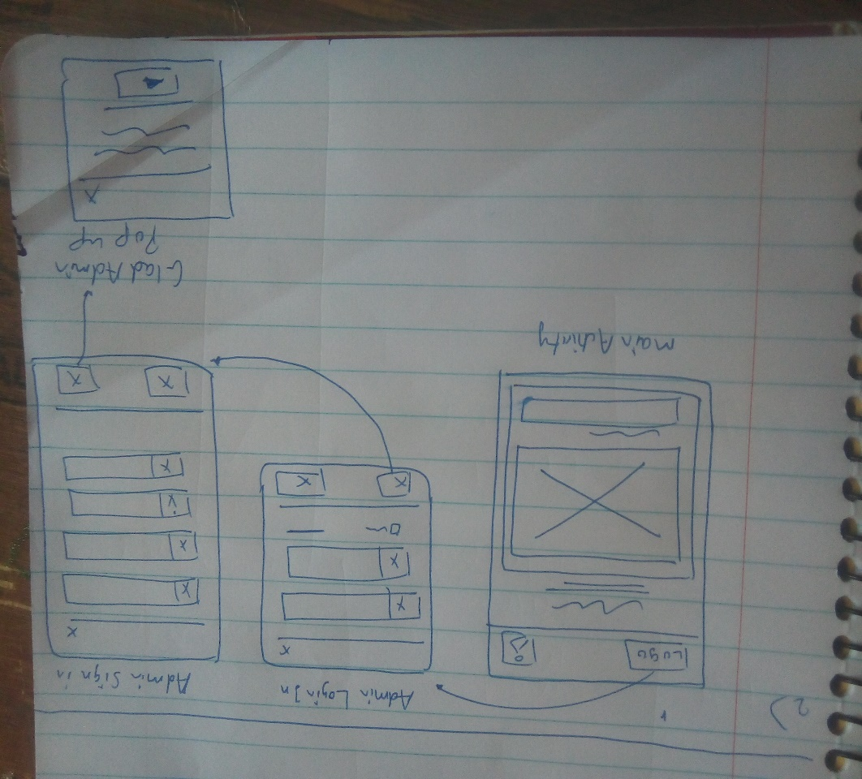
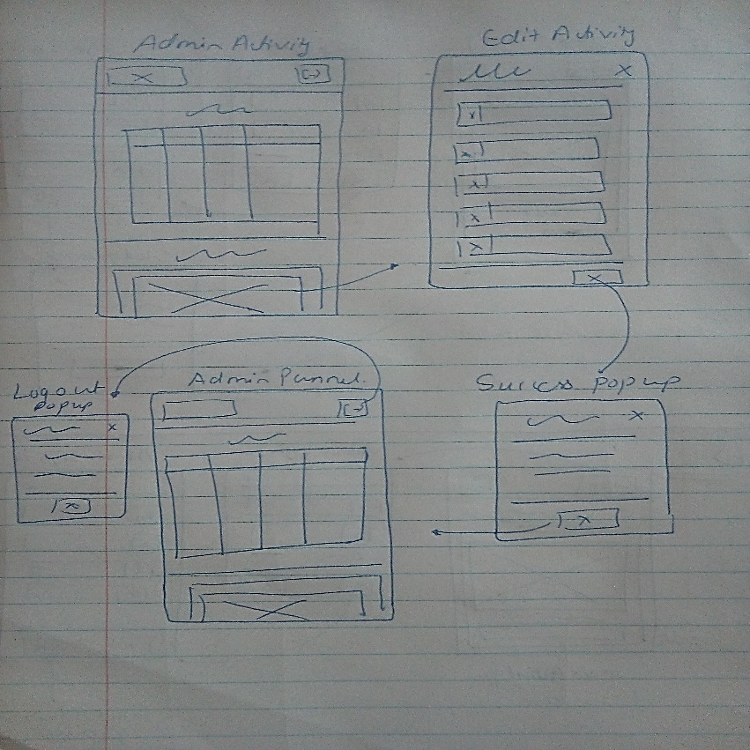
Wire Diagram
Main Activity
User Login / Sign in
Admin Panel

Slide 4
Activity Info
Admin View/ Panel
There admin is allow to do any changes if he want like add seminar
Admin Sign in/ Login
This is third activity where Admin Login is present or we can say the IEEE student co-ordinator
User Login/Sign In
This is second activity where if user want to reenroll for seminar then has to login to the system
Main Activity
This Is main Page of application where user will be welcomed as guest and list of event’s are mentioned
Sprint 3
Sprint 2
Sprint 1

Slide 5
Thank YOU
http://13.232.146.34/
siddhantjoshi501@gmail.com

